Slide 1
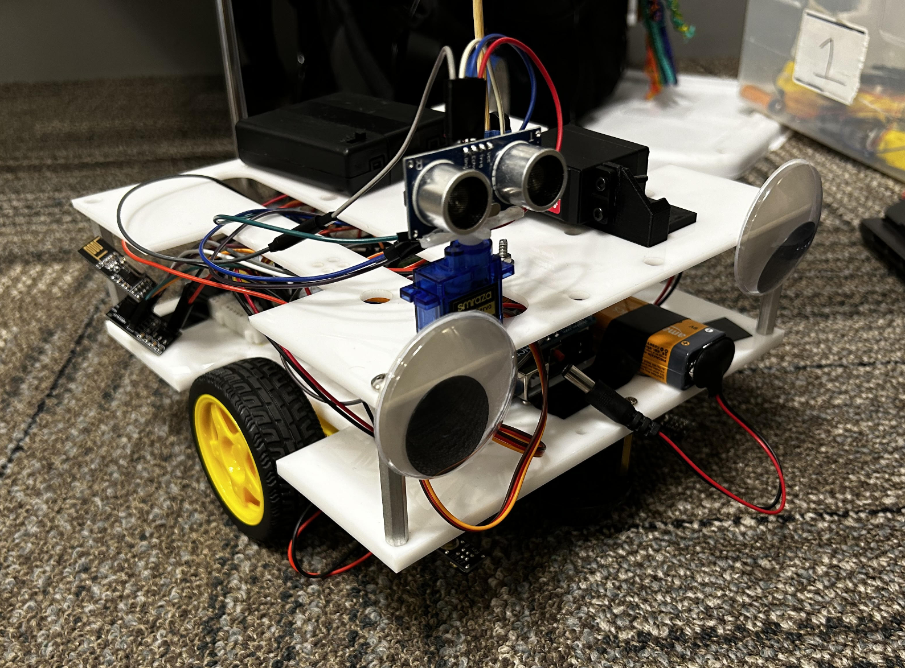
Team 1
Wireless Radio
Rotating distance sensor
TT motor driven wheel
IR Sensor
Ball bearing wheels
QTI sensors for line detection

